Slide 1
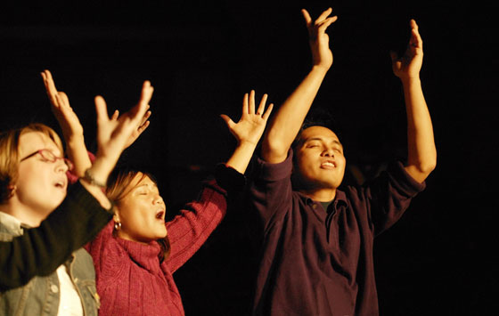
The history of the songs we sing

Slide 2
Down through history
Songs, music, dance and musical instruments developed and were passed on orally as part of family, community and national culture. Each culture developed its own distinctive music.
In Israel, the songs, music, dance and musical instruments became central in worshipping God. By the time that the Tanakh was completed (around 450BC) the Psalms had become the songbook for worship throughout the nation, and Israeli music had developed its own distinctive style. See Psalm 150.
In the 10th Century AD cantillation marks (cantillation points, tropes, te’amim) were added to the Hebrew words in the Tanakh with spaces for vowels to give an indication of how they were to be chanted or sung.
In ancient Israel
And God said, "Let the waters be collected." Genesis 1:9.
Letters in black, niqqud (vowel points) and d'geshim (gemination marks for lengthening consonants) in red, cantillation in blue.

Slide 3
Examples of Israeli music and dance
Explaining and demonstrating cantillation with a harp. https://www.youtube.com/watch?v=kh2KwEwaroc&ab_channel=HistoryMakersTV
Israeli dance
https://www.youtube.com/watch?v=egvyLJnoZrs&ab_channel=StevenEri
Singing with a shofar. https://www.youtube.com/watch?v=Rnkb7M3dKTg&ab_channel=YammaEnsemble-%D7%99%D7%90%D7%9E%D7%94-%D9%8A%D9%85%D8%A9

Slide 4
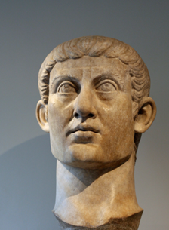
The first 400 years
The early Christians (gathering as ekklesia) were strongly persecuted and many were martyred. They met in homes. Singing to the Lord was a central part of their meeting together. Speak to one another with psalms, hymns and spiritual songs. Sing and make music in your heart to the Lord. Ephesians 5:19.
When Christianity was outlawed by the Romans and persecution became more intense home meetings of believers became more clandestine. Many Christians were martyred in the “great persecution” and the ekklesia went underground.
In 313AD Christian worship was decriminalised under Constantine, then in 380AD Christianity became the state religion of Rome. The institutional Church was born: the “Church of Rome”.
Constantine the Great

Slide 5
A religious structure soon developed based on the pagan Roman temples - with priests, sacrifices, and many rituals. Everything was in Latin. The term ‘Church’ (kyriakos – house of God) replaced the term ekklesia in the Vulgate (Latin) translation of the Bible and has been mistranslated ever since.
The earliest known hymn is the Oxyrhyncus hymn that was written in Greek around the time that the Roman Church was being established.
https://www.youtube.com/watch?v=ksqqcBanAhs&ab_channel=JohnHiltonIII

Slide 6
The next 1200 years From when the Church became the state religion of Rome (380AD) through to the Reformation (1520AD).
The Roman Catholic order of service gradually developed based on the Roman temples and their rituals (making sacrifices at an altar, priests, vestments, processions, icons, incantations etc.) The Mass was finalised by Pope Gregory (540–604AD) and has remained virtually unchanged ever since. It was in Latin, not in the common language of the people. “Singing” was chanting by the priests with responses by the people. The Mass and Canon Law were subject to the Law of Rome.

Slide 7
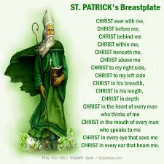
Equivalent religious systems developed in Eastern, Russian, Coptic … countries.
Chanting in the religious life was very important. Prayers, Scriptures, and rituals were chanted/sung routinely. In the Mass the priests chanted/sang the Kyrie, Gloria, blessings, prayers and dismissal - not the people.
A very early chant/song was ‘St Patrick’s breastplate’, written by St Patrick in Ireland around 433AD. It was translated into English and put to modern music in the 19th Century. https://www.youtube.com/watch?v=KUrERen9Vyc&ab_channel=ChetValleyChurches

Slide 8
I arise today through a mighty strength, the invocation of the Trinity; through belief in the Threeness; through confession of the Oneness of the Creator of creation. I arise today through the strength of Christ's birth with His baptism; through the strength of His crucifixion with His burial; through the strength of His resurrection with His ascension; through the strength of His descent for the judgment of doom. I arise today through the strength of the love of cherubim, in the obedience of angels, in the service of archangels, in the hope of resurrection to meet with reward, in the prayers of patriarchs, in the predictions of prophets, in the preaching of apostles, in the faith of confessors, in the innocence of holy virgins, in the deeds of righteous men. I arise today through the strength of heaven, the light of the sun, the radiance of the moon, the splendor of fire, the speed of lightning, the swiftness of wind, the depth of the sea, the stability of the earth, the firmness of rock.
I arise today, through God's strength to pilot me, God's might to uphold me, God's wisdom to guide me, God's eye to look before me, God's ear to hear me, God's word to speak for me, God's hand to guard me, God's shield to protect me, God's host to save me from snares of devils, from temptation of vices, from everyone who shall wish me ill, afar and near.

Slide 9
I summon today all these powers between me and those evils, against every cruel and merciless power that may oppose my body and soul, against incantations of false prophets, against black laws of pagandom, against false laws of heretics, against craft of idolatry, against spells of witches and smiths and wizards, against every knowledge that corrupts man's body and soul; Christ to shield me today against poison, against burning, against drowning, against wounding, so that there may come to me an abundance of reward. Christ with me, Christ before me, Christ behind me, Christ in me, Christ beneath me, Christ above me, Christ on my right, Christ on my left, Christ when I lie down, Christ when I sit down, Christ when I arise, Christ in the heart of every man who thinks of me, Christ in the mouth of everyone who speaks of me, Christ in every eye that sees me, Christ in every ear that hears me. I arise today through a mighty strength, the invocation of the Trinity, through belief in the Threeness, through confession of the Oneness of the Creator of creation.

Slide 10
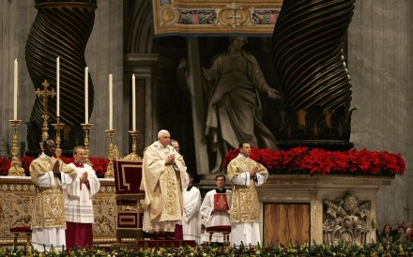
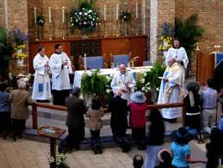
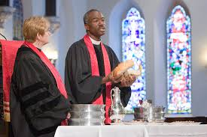
Then came the Reformation
Luther (1523) Lutheran tradition
Calvin (1541) Reformed tradition
Knox (1547) Presbyterian tradition
Henry VIII (1534) Anglican tradition
Catholic Anglican Presbyterian

Slide 11
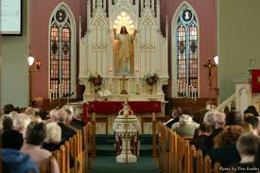
Luther introduced major differences (1523AD).
The service was in the language of the people rather than in Latin.
The sermon was the central act of the meeting.
The congregation could sing, not just the priests. (But Calvin banned organs, choirs and musical instruments because they are not mentioned in the New Testament).
The Eucharist was a memorial of the body and blood of Christ, not a re-sacrifice.
The people had to have a sombre attitude
in “the house of the Lord”. Sometimes people were fined for smiling in church! If people fell asleep they were poked with a knobbed staff by the ‘tithingman’ – “a parish officer elected annually to maintain order during divine service”.

Slide 12
A mighty fortress is our God, a bulwark never failing;
Our helper He amid the flood, of mortal ills prevailing.
For still our ancient foe, doth seek to work us woe;
his craft and power are great, and armed with cruel hate,
on earth is not his equal.
Did we in our own strength confide, our striving would be losing,
were not the right Man on our side, the man of God's own choosing.
Dost ask who that may be? Christ Jesus, it is He;
Lord Sabaoth, His name, from age to age the same, and He must win the battle.
And though this world, with devils filled, should threaten to undo us,
We will not fear, for God hath willed, His truth to triumph through us.
The Prince of Darkness grim, we tremble not for him;
his rage we can endure, for lo, his doom is sure; one little word shall fell him.
That word above all earthly powers, no thanks to them, abideth;
The Spirit and the gifts are ours, thru Him who with us sideth.
Let goods and kindred go, this mortal life also;
The body they may kill; God's truth abideth still; His kingdom is forever.
Martin Luther. 1529AD

Slide 13
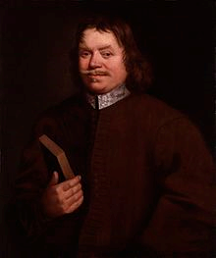
Protests against the Church of England’s liturgy
In the 1660s “the Dissenters” left the Church of England in the “great ejection” because they disagreed with aspects of the “Book of Common prayer”. They included Presbyterians, Unitarians, Baptists and Congregationalists. The “Act of Toleration” 1689 allowed “non-conformists” or “protestants” to worship as long as they pledged allegiance to the King, and rejected transubstantiation.
John Bunyan was a dissenter. He spent most of his life in jail because he refused to stop preaching. He wrote ‘Pilgrims progress’ and ‘Who would true valour see’while in jail.
John Bunyan

Slide 14
Who would true valour see, let him come hither; One here will constant be, come wind, come weather. There’s no discouragement, shall make him once relent His first avowed intent: to be a pilgrim.
Whoso beset him round with dismal stories Do but themselves confound; His strength the more is. No lion can him fright, he’ll with a giant fight, But he will have a right, to be a pilgrim.
Hobgoblin nor foul fiend, can daunt his spirit, He knows he at the end, shall life inherit. Then fancies fly away, he’ll fear not what men say, He’ll labour night and day, to be a pilgrim.
John Bunyan 1684

Slide 15
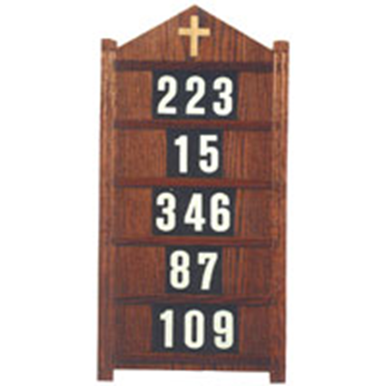
Hymn singing became part of Protestant culture, and many wonderful hymns were written.
The Puritans introduced the “hymn sandwich” order of worship that became popular in most Protestant churches.
Call to worship
Hymn
Prayer
Reading
Hymn
Prayer
Reading
Pre-sermon prayer
Sermon
Collection
Communion
Hymn
Benediction

Slide 16
When I survey the wondrous cross On which the Prince of glory died, My richest gain I count but loss, And pour contempt on all my pride.
Forbid it, Lord, that I should boast, Save in the death of Christ my God! All the vain things that charm me most, I sacrifice them to His blood.
See from His head, His hands, His feet, Sorrow and love flow mingled down! Did e’er such love and sorrow meet, Or thorns compose so rich a crown?
Were the whole realm of nature mine, That were an offering far too small; Love so amazing, so divine, Demands my soul, my life, my all.
Isaac Watts 1707

Slide 17
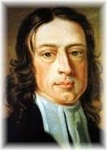
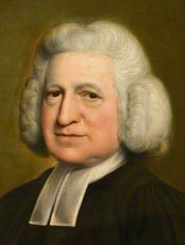
The 18th and 19th centuries
During the 18th and 19th centuries there was a great emphasis on evangelism, revival and overseas mission. Worldwide, conversion of ‘the heathen’ by colonisation began, with many appalling acts between Catholics, Anglicans and Protestants.
John Wesley (1703 – 1791) founded the Methodists. Wesley’s rules (methods), work and writings played a leading role in the development of the Holiness Movement, Revivalism and Pentecostalism.
John’s brother Charles (1707-1788) wrote many of our greatest hymns.
John Wesley
Charles Wesley

Slide 18
And can it be that I should gain, an interest in the Saviour’s blood? Died He for me, who caused His pain - for me, who Him to death pursued? Amazing love! How can it be, that Thou, my God, shouldst die for me?
’Tis mystery all: the Immortal dies: who can explore His strange design? In vain the firstborn seraph tries, to sound the depths of love divine. ’Tis mercy all! Let earth adore, let angel minds inquire no more.
He left His Father’s throne above, so free, so infinite His grace - Emptied Himself of all but love, and bled for Adam’s helpless race: ’Tis mercy all, immense and free, for O my God, it found out me!
Long my imprisoned spirit lay, fast bound in sin and nature’s night; Thine eye diffused a quickening ray - I woke, the dungeon flamed with light; My chains fell off, my heart was free, I rose, went forth, and followed Thee.
No condemnation now I dread; Jesus, and all in Him, is mine; Alive in Him, my living Head, and clothed in righteousness divine, Bold I approach the eternal throne, and claim the crown, through Christ my own.
Charles Wesley 1780

Slide 19
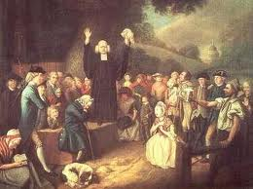
The Revivalists
Popular Revivalist preachers like George Whitefield, Charles Finney, DL Moody and Charles Spurgeon strongly influenced Protestant churches, including the Methodists.
The goal of preaching was to save lost souls. Every sermon was a gospel message. “God loves you and has a wonderful plan for your life”.
Music and hymns (especially after the sermon) were designed to bring about an emotional response to the gospel message. e.g. The Old Rugged Cross, Power in the blood; Have Thine own way, Lord; Just as I am.
People were invited to come forward to a “mourning bench” to repent of their sins. This soon changed to an “anxious bench” and then coming forward to the altar in an “altar call”.

Slide 20
Just as I am, without one plea, but that Thy blood was shed for me, and that Thou bidst me come to Thee, O Lamb of God, I come, I come. Just as I am, and waiting not, to rid my soul of one dark blot, to Thee whose blood can cleanse each spot, O Lamb of God, I come, I come. Just as I am, though tossed about, with many a conflict, many a doubt, fightings and fears within, without, O Lamb of God, I come, I come. Just as I am, poor, wretched, blind; sight, riches, healing of the mind, yea, all I need in Thee to find, O Lamb of God, I come, I come. Just as I am, Thou wilt receive, wilt welcome, pardon, cleanse, relieve; because Thy promise I believe, O Lamb of God, I come, I come. Just as I am, Thy love unknown, hath broken every barrier down; now, to be Thine, yea Thine alone, O Lamb of God, I come, I come.
Charlotte Elliot 1835.

Slide 21
On a hill far away stood an old rugged cross, the emblem of suffering and shame;
And I love that old cross where the Dearest and Best, for a world of lost sinners was slain.
So I’ll cherish the old rugged cross, till my trophies at last I lay down;
I will cling to the old rugged cross, and exchange it someday for a crown.
Oh, that old rugged cross, so despised by the world, has a wondrous attraction for me;
For the dear Lamb of God left His glory above, to bear it to dark Calvary.
In that old rugged cross, stained with blood so divine, a wondrous beauty I see,
For ’twas on that old cross Jesus suffered and died, to pardon and sanctify me.
To the old rugged cross I will ever be true;, its shame and reproach gladly bear;
Then He’ll call me someday to my home far away, where His glory forever I’ll share.
George Bennard 1913

Slide 22
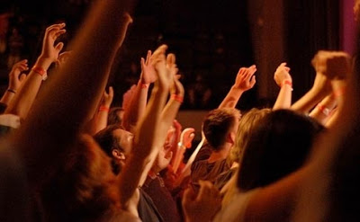
20th century Pentecostalism
The “order of service” in Pentecostal meetings (1906 on) was much the same as in other evangelical churches but it had extra dimensions:
“Worship” became something that was done rather than something that was attended. It had a strongly emotional expression; repetitive songs; lifting of hands; dancing; clapping; exercise of spiritual gifts especially speaking in tongues; use of guitars, drums and tambourines; singing in the Spirit; and a desire to flow in the Spirit.
Choruses of hymns were sung over and over. e.g. Turn your eyes upon Jesus. Many similar short songs were written and became known as “choruses”. These became the main songs sung in Pentecostal worship.

Slide 23
Turn your eyes upon Jesus, look full in His wonderful face And the things of earth will grow strangely dim In the light of His glory and grace.
Oh soul are you weary and troubled? No light in the darkness to see? There's a light for a look at the Saviour, and life more abundant and free.
His words shall not fail you, He promised.
Believe Him and all will be well. Then go to a world that is dying, His perfect salvation to tell.
Helen Lemmel. 1922.

Slide 24
The Charismatic renewal (late 1960’s on)
The Charismatic renewal affected the worship in most churches including Catholic, Anglican, Presbyterian, Pentecostal and evangelical. Reformed churches were least affected. Initially there was much resistance and division, but, over time, most churches opened up and incorporated aspects of the renewal.
The service was led by the Pastor with delegated “worship leaders” and a “worship team”. People were able to be involved in the meeting in a wide range of ways.
Worship was accompanied by guitars and/or a band. It was mostly choruses and occasionally a hymn. Major contributions came from “Scripture in Song”; “Gaither gospel music”, Keith Green, Negro spirituals, Amy Grant and Anglican folk music.
There was much openness to “flowing in the Spirit” and exercising of the gifts of the Holy Spirit, especially in home meetings. These home meetings were very much like the original meetings of the ekklesia with everyone encouraged to contribute, and much love.

Slide 25
Thou art worthy, Thou art worthy, Thou art worthy O Lord.
To receive glory, glory and honour, glory and honour and power.
For Thou hast created; hast all things created; Thou hast created all things. And for Thy pleasure, they are created
Thou art worthy O Lord. 1963 Revelation 4:11
Shackled by a heavy burden; ‘neath a load of guilt and shame
Then the hand of Jesus touched me, and now I am no longer the same.
He touched me, O He touched me. And O the joy that floods my soul.
Something happened and now I know: He touched me and made me whole.
Since I met this blessed Saviour; since He cleansed and made me whole; I will never cease to praise Him; I’ll shout it while eternity rolls.
1963 Bill and Gloria Gaither
His name is wonderful; His name is wonderful, His name is wonderful,
Jesus, my Lord. He is the Mighty King; Master of everything;
His name is wonderful, Jesus my Lord.
He’s the Great Shepherd; The Rock of all Ages; Almighty God is He:
Bow down before Him; love and adore Him, His name is wonderful,
Jesus my Lord. 1971 Manna Music

Slide 26
This has opened up a flood of wonderful “worship songs” which we are now able to sing!
Jesus, name above all names; Beautiful Saviour, Glorious Lord.
Immanuel, God is with us; Blessed Redeemer, Living Word.
1974. Scripture in Song
When I look into Your holiness, when I gaze into Your loveliness
When all things that surround become shadows in the light of You.
When I've found the joy of reaching Your heart,
When my will becomes enthralled in Your love.
When all things that surround become shadows in the light of You.
I worship You, I worship You. The reason I live is to worship You.
I worship You, I worship You. The reason I live is to worship You.
1981. Integrity music.
Majesty, worship His majesty, unto Jesus be all glory, power and praise.
Majesty, Kingdom authority, flows from His throne, unto His own: His anthem raise. So exalt, lift up on high the name of Jesus.
Magnify, come glorify Christ Jesus the King.
Majesty, worship His majesty: Jesus who died,
Now glorified, king of all Kings. 1981. Jack Hayford.

Slide 27
Since the 1990s Hillsong, Chris Tomlin, Matt Redman, Graham Kendrick, Bethel etc. have been major leaders in the style of music we sing:
Thank you for the cross Lord, thank you for the price You paid.
Bearing all my sin and shame, in love You came, and gave amazing grace.
Thank you for this love Lord, Thank you for the nail pierced hands.
Washed me in Your cleansing flow, now all I know
Your forgiveness and embrace.
Worthy is the Lamb, seated on the throne;
Crown You now with many crowns, You reign victorious.
High and lifted up, Jesus Son of God;
The Darling of Heaven crucified,
Worthy is the Lamb, Worthy is the Lamb

Slide 28
In recent years
Since Vatican 2 (1965) the Catholic Mass is in the local language and the people are able to sing.
There are wide variations in church liturgies depending on how traditional or conservative the churches are. South America, Africa and many parts of Asia are conservatively Catholic or Protestant. Christianity in Europe is in major decline; America is declining rapidly but has strong Protestant conservative areas. NZ and Australia are at the forefront of secularisation. At the same time Islam is increasing dramatically through planned population growth, “evangelism” and radical extremism.
The Charismatic renewal has died down but aspects of it have become mainstream in most churches. e.g. choruses and more involvement of the people. Exercise of spiritual gifts is rare.
In NZ liberal churches e.g. Methodist, have nearly died out. Catholic, Reformed and most older denominations have no or few young people and are going the same way. Young people tend to go to the mega-churches, perhaps attracted by their concert approach.

Slide 29
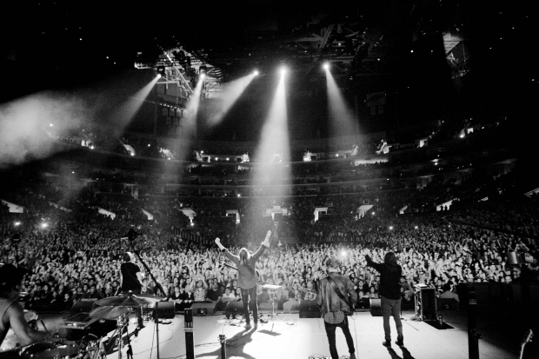
The songs of the modern mega-church seem to be becoming increasingly focused on people within their sub-culture, and bear little resemblance to the songs of the past. https://www.youtube.com/watch?v=-egY6t9BMGI&ab_channel=Antiochmbcmusic
Still, the songs we sing today are certainly built on a rich heritage!
Let’s finish with two of the best:

Slide 30
Amazing grace! How sweet the sound, that saved a wretch like me!
I once was lost, but now am found; was blind, but now I see.
’Twas grace that taught my heart to fear, and grace my fears relieved;
How precious did that grace appear, the hour I first believed.
Through many dangers, toils and snares, I have already come;
’Tis grace hath brought me safe thus far, and grace will lead me home.
The Lord has promised good to me, His Word my hope secures;
He will my Shield and Portion be, as long as life endures.
Yea, when this flesh and heart shall fail, and mortal life shall cease,
I shall possess, within the veil, a life of joy and peace.
The earth shall soon dissolve like snow, the sun forbear to shine;
But God, who called me here below, will be forever mine.
When we’ve been there ten thousand years, bright shining as the sun,
We’ve no less days to sing God’s praise, than when we’d first begun.
John Newton 1779.

Slide 31
O Lord my God, when I in awesome wonder
Consider all the works Thy Hand hath made,
I see the stars, I hear the mighty thunder,
Thy power throughout the universe displayed;
Then sings my soul, my Saviour God, to Thee,
How great Thou art! How great Thou art!
When through the woods and forest glades I wander.
I hear the birds sing sweetly in the trees;
When I look down from lofty mountain grandeur
And hear the brook and feel the gentle breeze;
And when I think, that God, His Son not sparing;
Sent Him to die, I scarce can take it in;
That on the Cross, my burden gladly bearing,
He bled and died to take away my sin.
When Christ shall come, with shouts of acclamation,
And take me home, what joy shall fill my heart!
Then I shall bow in humble adoration
And there proclaim, "My God, how great Thou art!"
Carl Gustav Boberg 1885, translated by Stuart K Hine

